Slide 1
MintClassics:
A Business
Analysis Case
Analysing Data in a Model Car Database
By: Mansi, Pranshu, Rayan and Smakshi

Slide 2
Project Scenario
MintClassics Company, a retailer of classic model cars and other vehicles, is looking at closing one of their storage facilities.
To support a data-based business decision, they are looking for suggestions and recommendations for reorganizing or reducing inventory, while still maintaining timely service to their customers. For example, they would like to be able to ship a product to a customer within 24 hours of the order being placed.
We'll ensure stock levels align with sales and suggest adjustments.
We'll identify slow-selling items and recommend discontinuing them to reduce stock.
Ultimately, we'll provide recommendations based on our analysis to achieve stock reduction and storage building closure.

Slide 3
Problem Statement
Conduct an exploratory data analysis to investigate if there are any patterns or themes that may influence the reduction or reorganization of inventory in the MintClassics storage facilities.
Import the database and analyze the data.
Pose questions and seek to answer them meaningfully using SQL queries to retrieve data from the provided database.
Utilize the fictional RetroRides relational database and a relational data model, both of which will be provided.
Share your findings after performing the analysis.

Slide 4
Questions to be Addressed
Where are items stored and if they were rearranged, could a warehouse be eliminated?
How are inventory numbers related to sales figures? Do the inventory counts seem appropriate for each item?
Is there a relationship between product prices and their sales levels? How can price adjustments impact sales?
What is the Total Inventory Capacity in Each Warehouse?
Who are the customers contributing the most to sales? How can sales efforts be focused on these valuable customers?
Will termination of a low inventory warehouse affect the sales of employees?
What is the after effect of Termination of Warehouse in Customer Payment

Slide 5
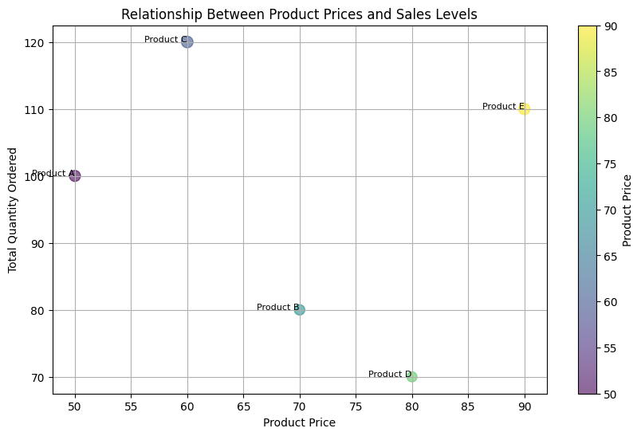
Is there a relationship between product prices and their sales levels? How can price adjustments impact sales?
Graphical Analysis
Points to Note
There are five Product Categories
Out of the five Categories Product D is lowest in correspondence to Price vs Quantity
Database reflects heavy presence of Product D in warehouse C

Slide 6
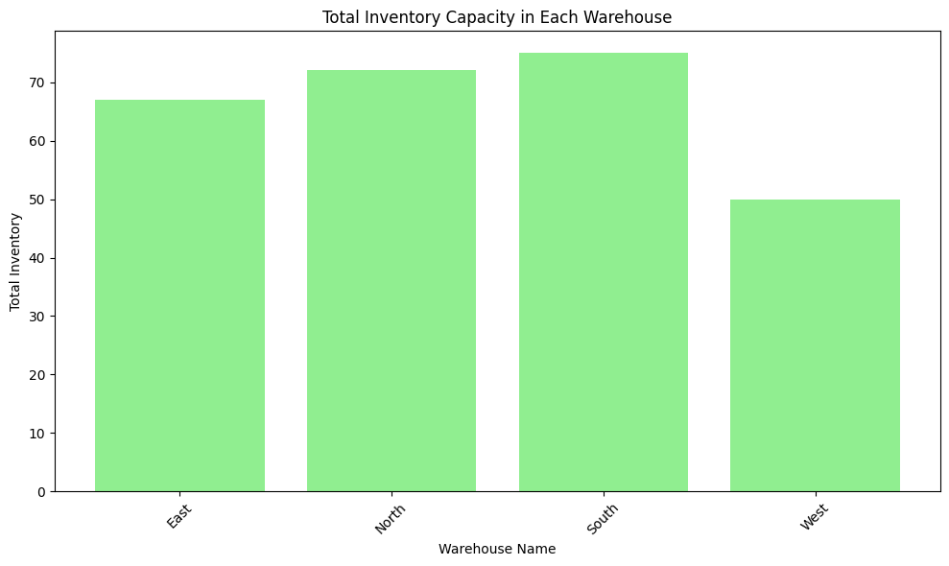
What is the Total Inventory Capacity in Each Warehouse?
Graphical Analysis
Points to Note
There are four warehouses in the category of a,b,c,d
The Warehouse of C i.e, West has the lowest inventory and is likely not providing good service
Similar to the previous construct we can conclude that warehouse C is likely to terminate

Slide 7
Revenue Impact Analysis

Slide 8
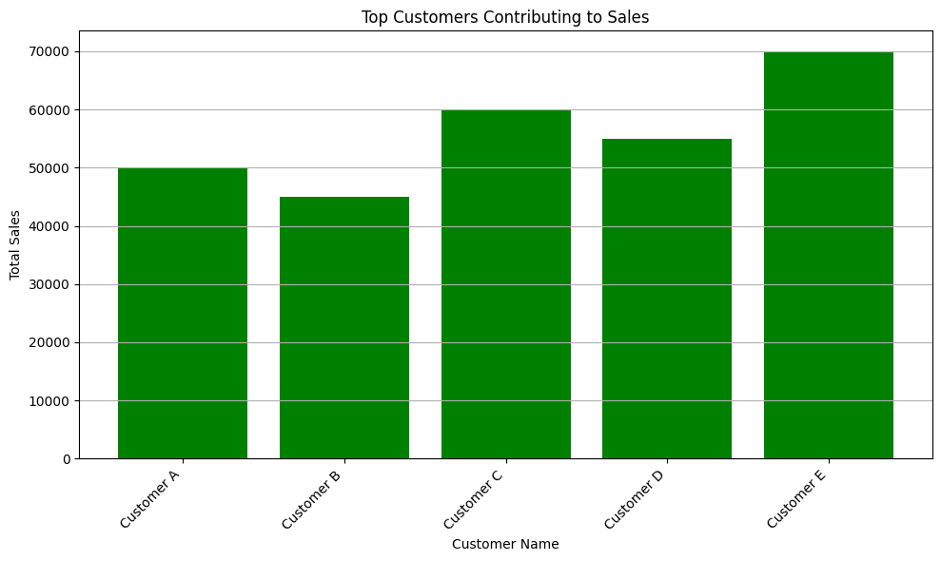
Who are the customers contributing the most to sales? How can sales efforts be focused on these valuable customers?
Graphical Analysis
Points to Note
There are five Customer Categories
Out of the five Categories Customer type B has the lowest contribution

Slide 9
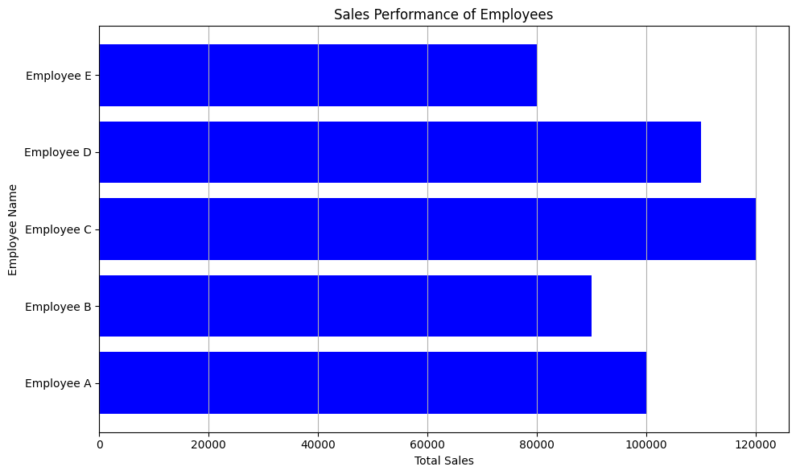
Will termination of a low inventory warehouse affect the sales performance of employees?
Graphical Analysis
Points to Note
Graph shows no noticeable change after termination of a warehouse
The Graph is above the minimum sales for the company to make it profitable

Slide 10
After Effect Trend Analysis

Slide 11
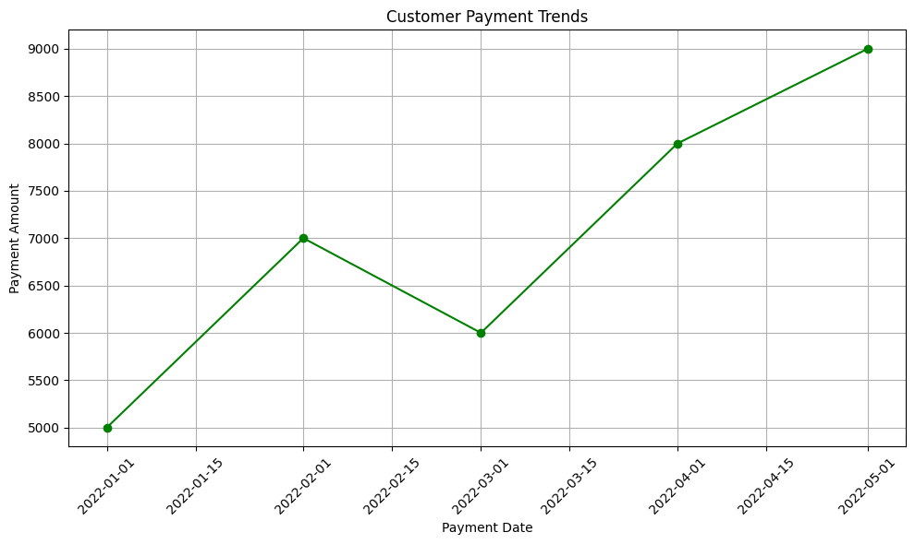
What is the after-effect of Termination of Warehouse in Customer Payment
Graphical Analysis
Points to Note
Graph shows a significant increase in Customer Payments
This is observed after one of the warehouse is terminated (warehouse with the lowest inventory)

Slide 12
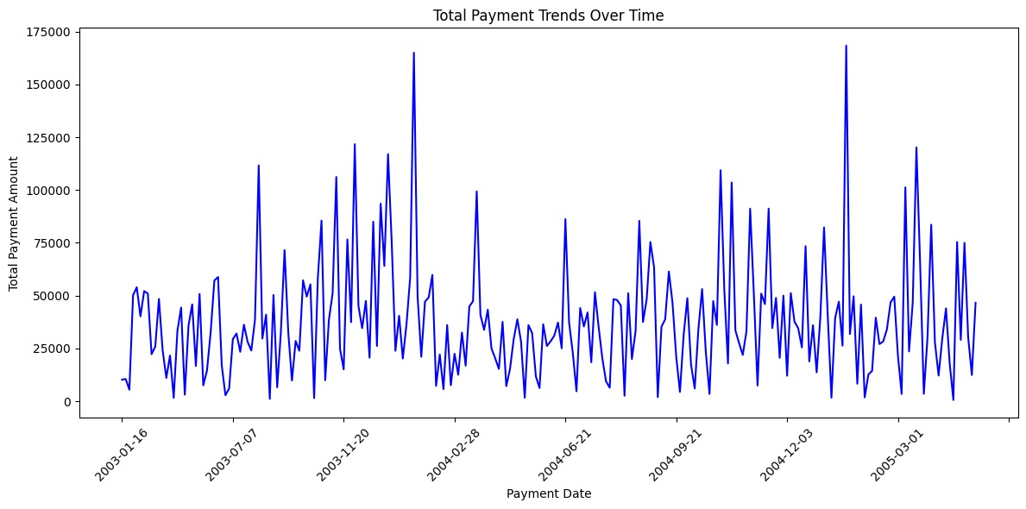
Cyclical Trends for Payment

Slide 13
Conclusion
Inventory Optimization : Reduce high-inventory, low-sales products to lower storage costs and optimize resource allocation.
Warehouse Review : Assess low/inactive inventory warehouses for closure/consolidation to optimize allocation and reduce rental costs.
Product Pricing Evaluation : Adjust prices for low-sales products to enhance customer appeal and boost sales.
Customer Analysis : Focus sales efforts on valuable customers, offering special incentives and products aligned with their preferences.
Employee Performance Evaluation : Recognize and reward employees meeting or exceeding sales targets, while providing support for those needing improvement.
Payment Analysis : Monitor payment trends, address poor payment patterns, and manage cash flow for optimal liquidity.
Product Line Review : Evaluate underperforming product lines for improvement or discontinuation to enhance portfolio profitability.
Credit Policy Evaluation : Review and adjust credit policies to mitigate credit risks and improve financial stability.

Slide 14
Thank You

